Slide 1
Variations on a Dipole
Antenna patterns are all about interference
Gary Rondeau
AF7NX

Slide 2
What is an Antenna?
Transforms and electrical signal into a propagating electromagnetic wave OR vise versa. - Transducer – goes both ways.
TX and RX antennas have different jobs. For TX want to generate as much propagated power, where you want it, as possible. For RX want to have very good S/N for your received signal.
Impedance match – 50 Ω radio to 377 Ω free space EM wave.

Slide 3
What to put up?
What resources do you have?
Trees ( I’ve got these)
Tall attic or barn for a fixed Yagi
Average for a Beverage
Room for a tower & stacked multi-element multi-band Yagis ($$$)!!
Wires are flexible and inexpensive – nice if you have trees.
Buy or Build?
Do you want DX and/or Regional reach?
What bands?

Slide 4
Resonant Wire Antennas
Works for both TX and RX
Work well for coupling electical power into EM wave.
Waves on a wire – properties:
  No current at the ends of the wire.
  Impedance along the wire is v/i
  Wire is both inductor and capacitor for the electrical activity on the wire.

Slide 5
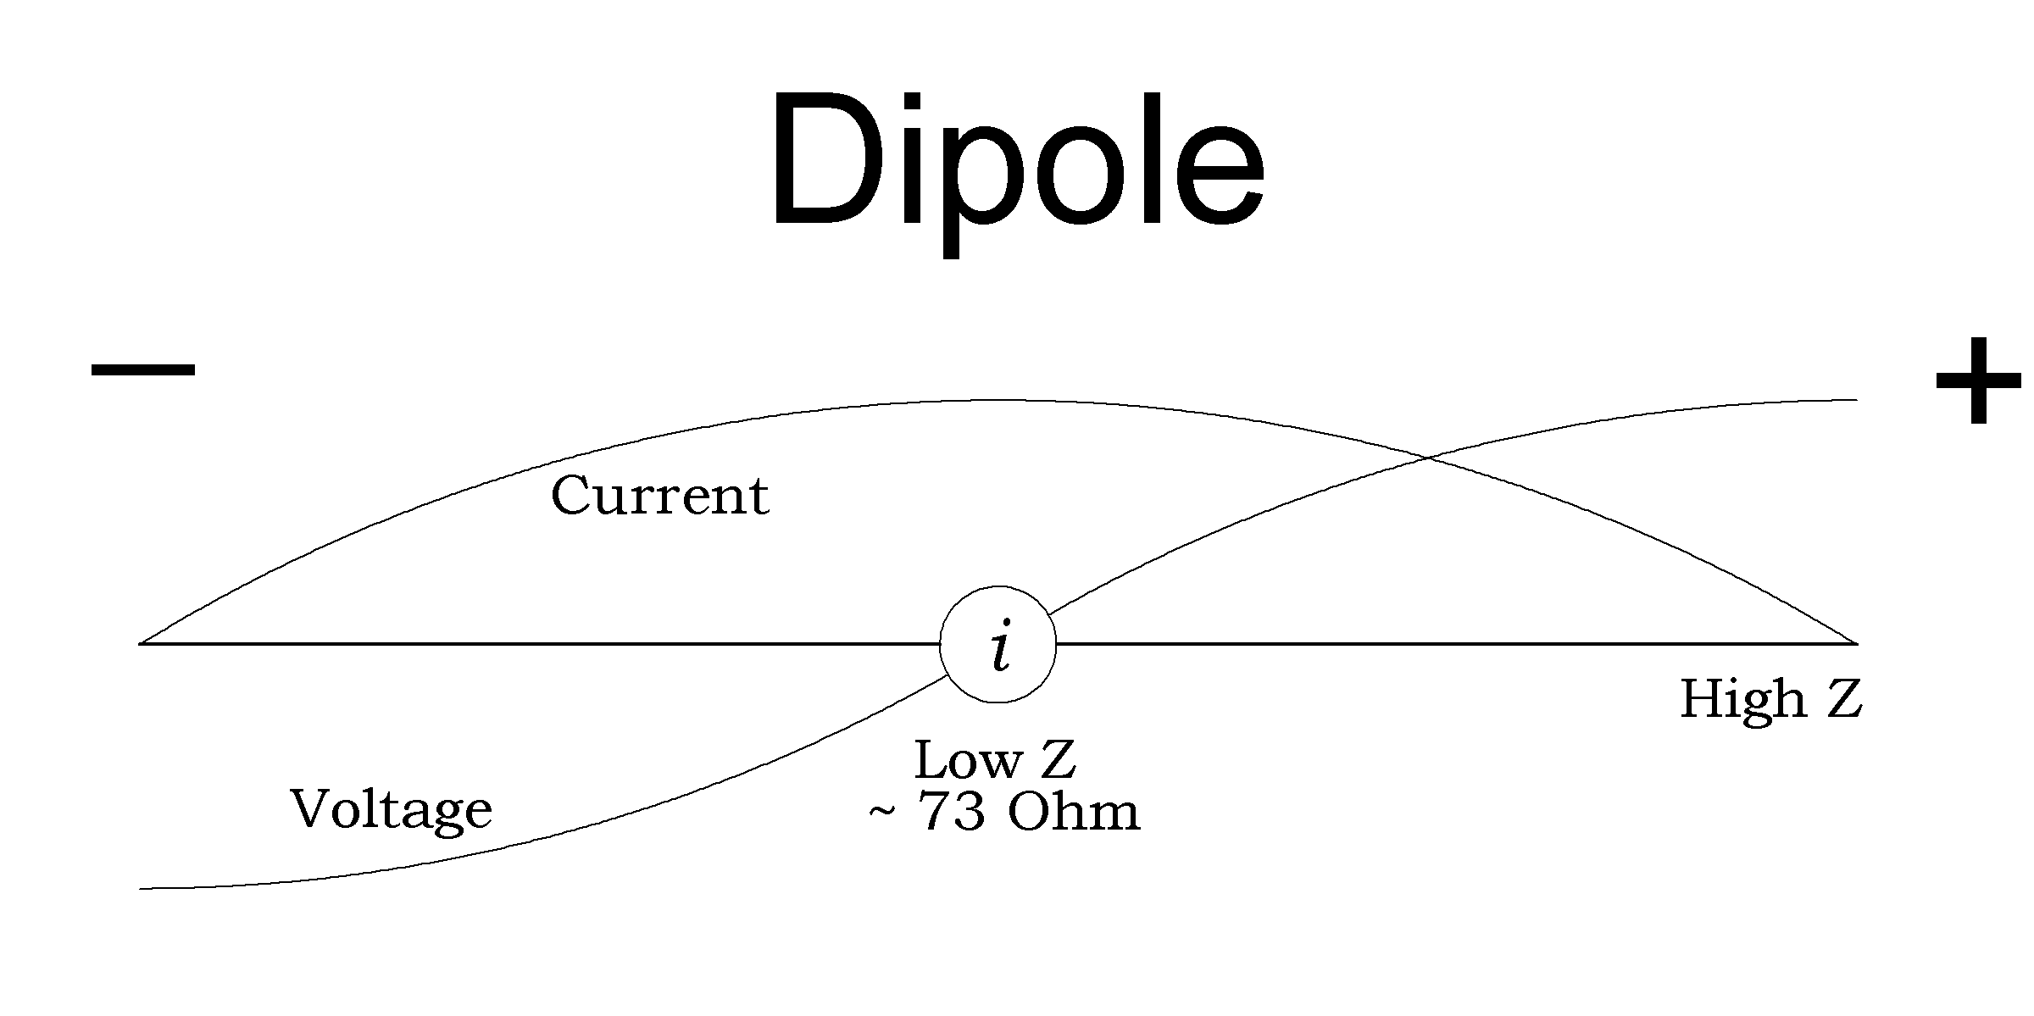
A Wave on a wire
Ends of dipole are capacitive
Center of dipole is inductive
Impedance varies along the length of the wire
Resonance → l = n λ/2

Slide 6
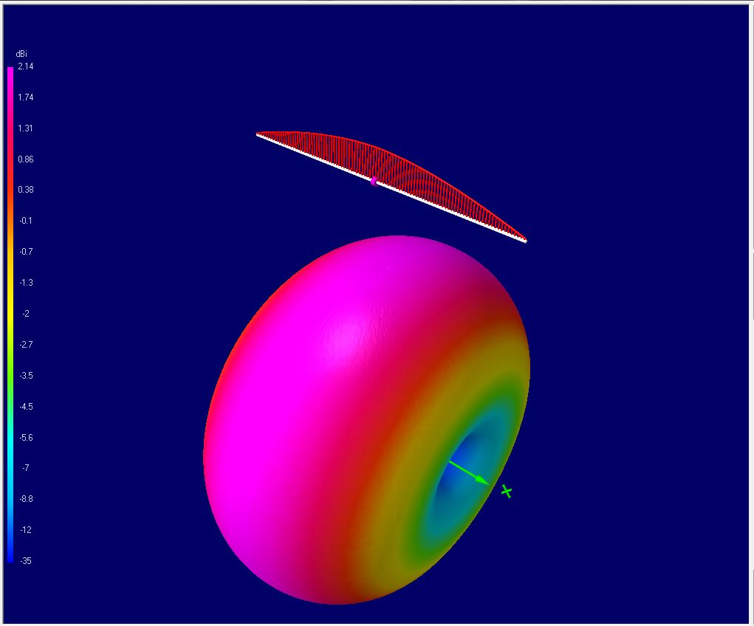
The Dipole in Freespace
Dipole in Free Space

Slide 7
Ground
The perfect ground assumption
Can’t have E-fields along conductive surface
Images help to understand antennas over ground. A mirror reflects left to right, but stays the same up and down. (Why!?!)

Slide 8
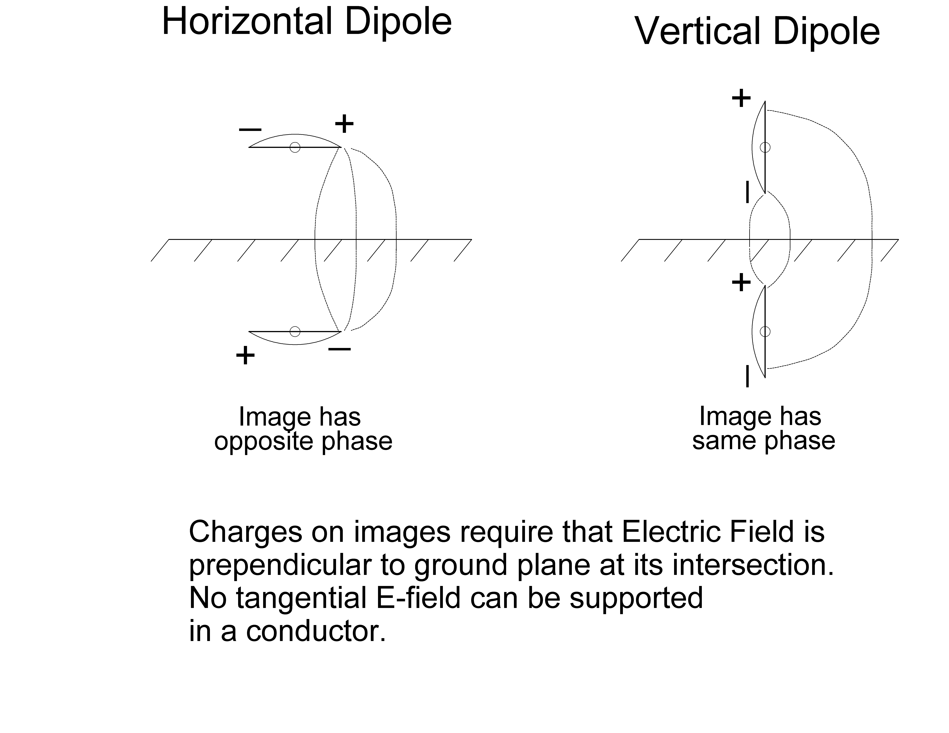
Ground Images

Slide 9
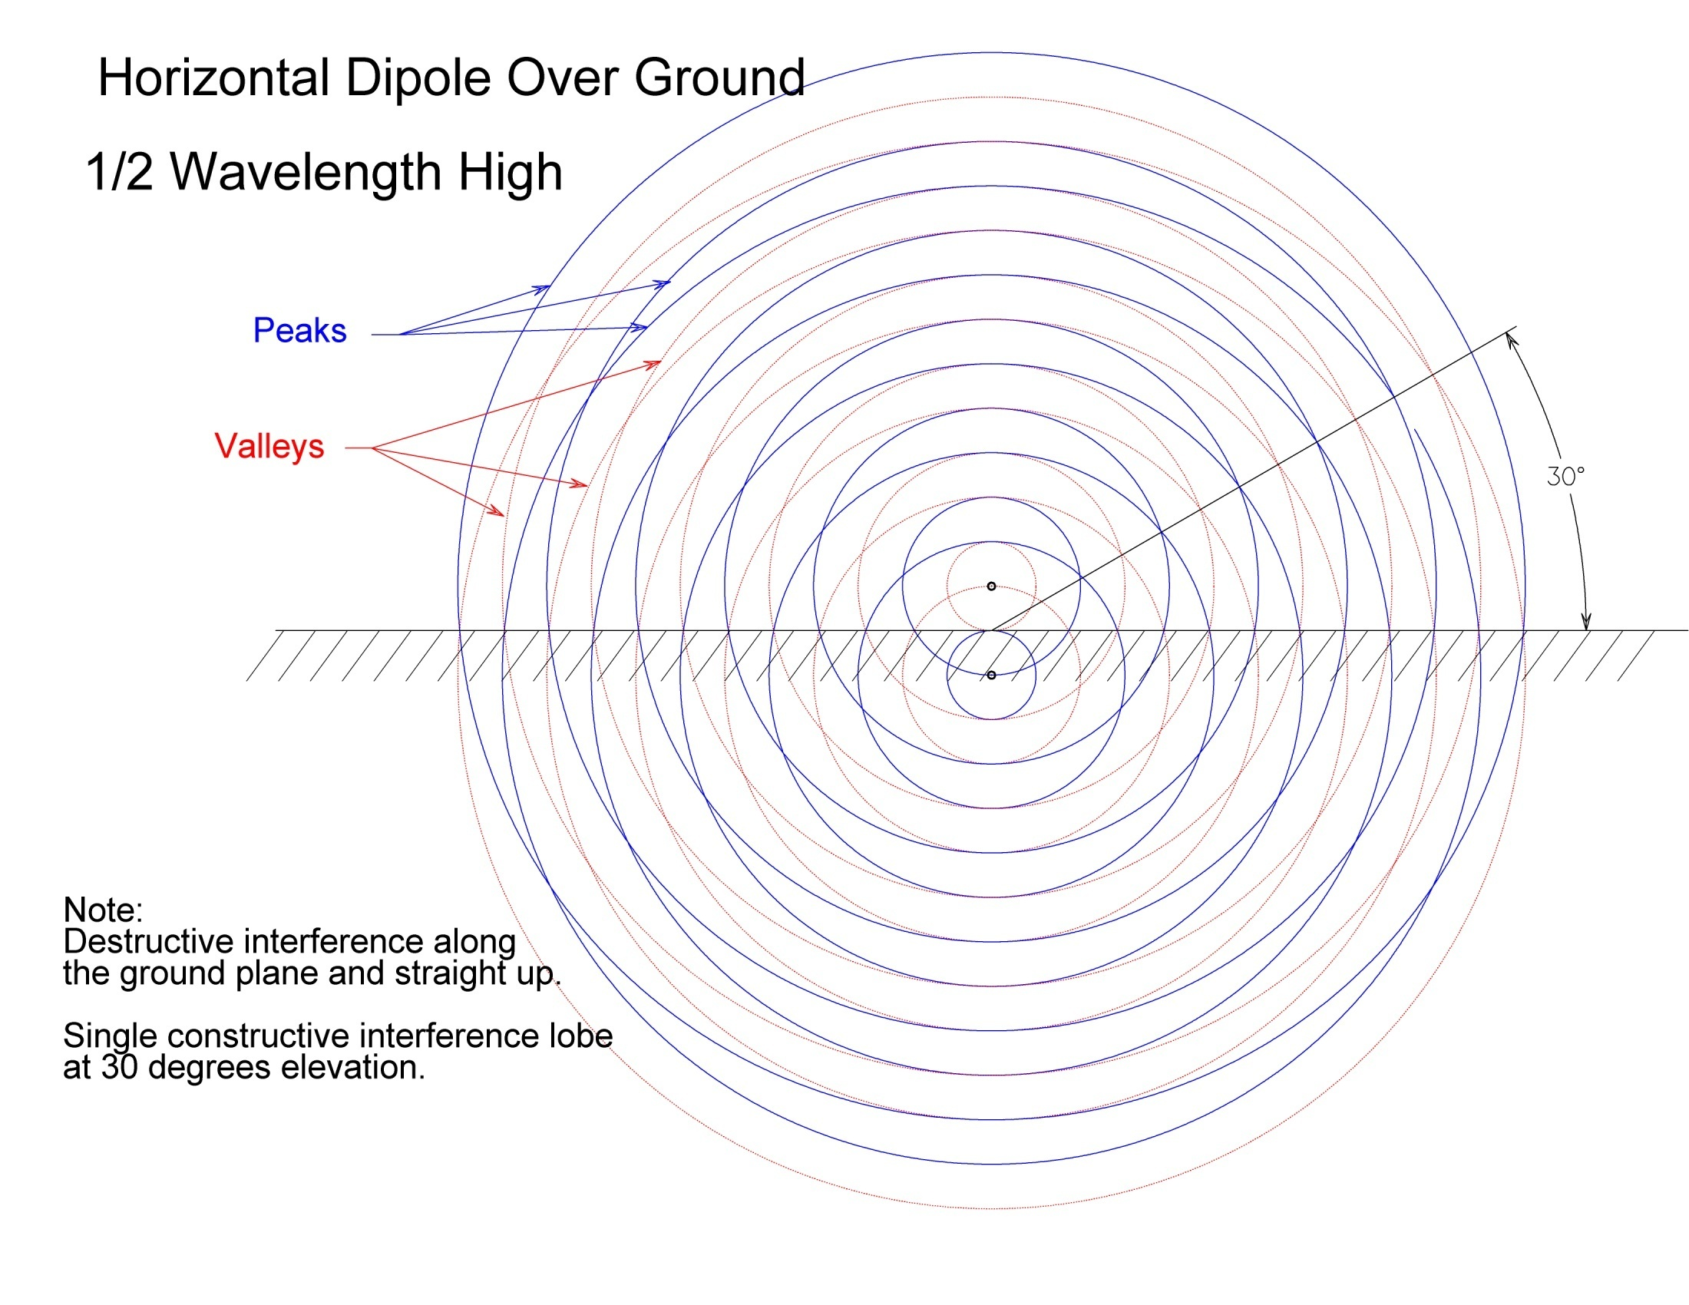
Interference from Ground Image

Slide 10
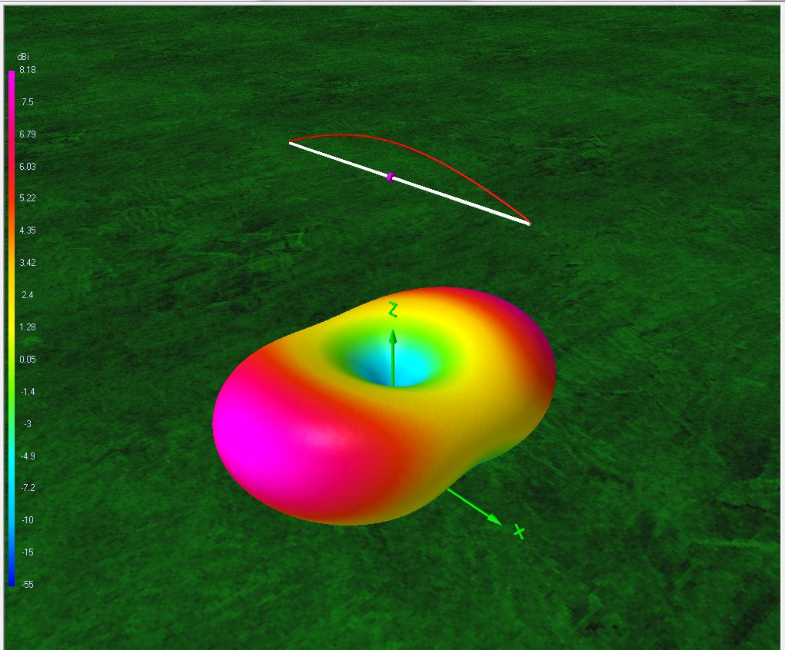
Dipole Over Perfect Ground ½ λ High
Dipole λ/2 above Perfect Ground

Slide 11
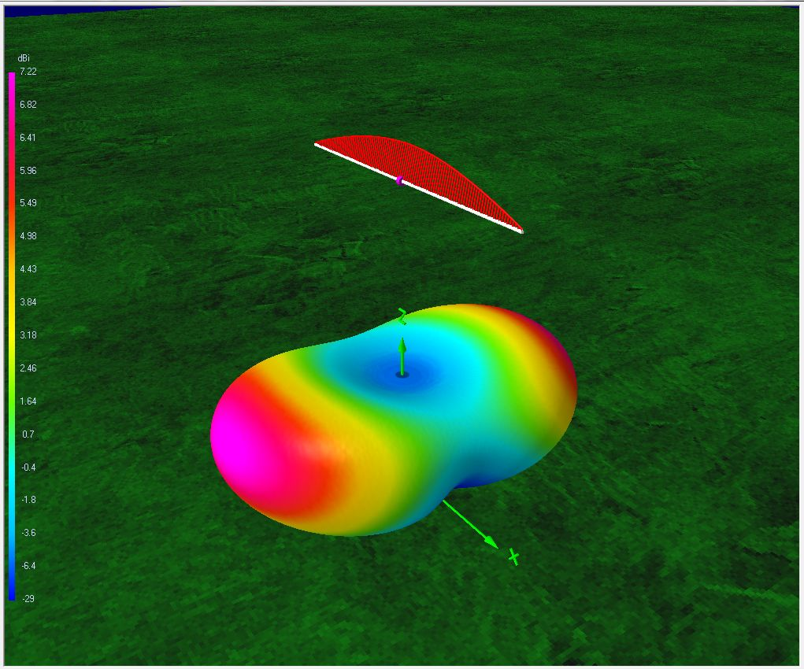
Dipole ½ λ Over Real Ground
Dipole λ/2 above Real Ground

Slide 12
Horizontal Dipoles - Height Scaling
Always a null at the horizon!
For low antennas < ½ λ high, the positive interference moves skyward. Sky warmers and NVIS (Near Vertical Incidence Sky-wave) antennas.
Elevation angle of first lobe gets closer to the horizon as the antenna goes up.
You get more lobes as you go up.

Slide 13
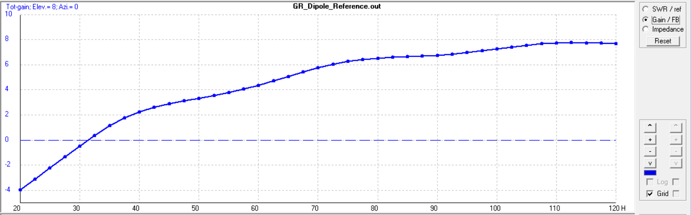
Horz. Dipole Gain at 8° -vs- Height
Height in Feet for 20m Dipole

Slide 14
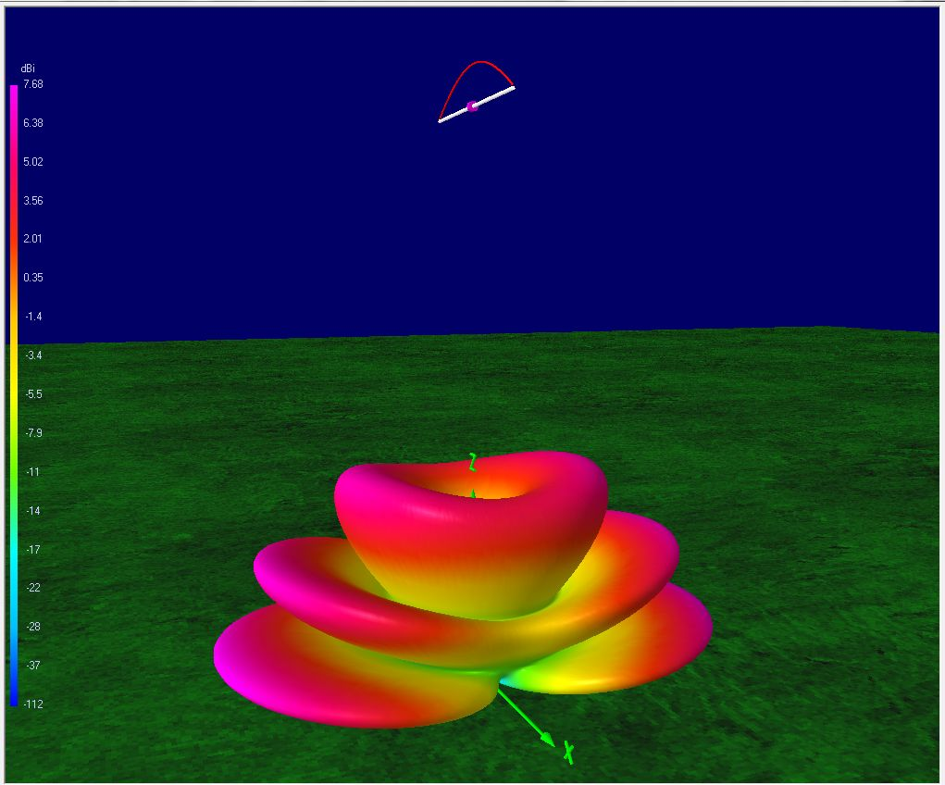
Dipole 3λ/2 High Over Real Ground
Dipole 3λ/2 Above Real Ground

Slide 15
What about Verticals?
Azimuthally Symmetric
Ground image Adds at the Horizon
No propagation perfectly upward
Ground plane ¼ wave antenna (radials)
Raised vertical dipole antenna (no radials)

Slide 16
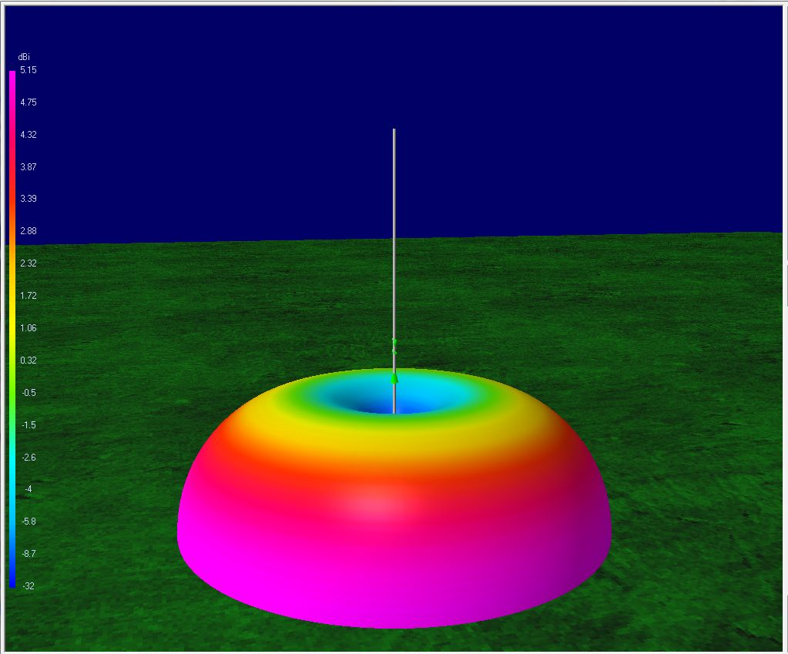
¼ λ Vertical – Perfect Ground
λ/4 Vertical -- Perfect Ground

Slide 17
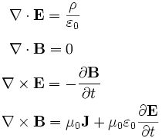
How do EM Waves Propagate?
Charges give rise to Electric fields
There are no Magnetic monopoles
Changing magnetic fields make electric fields in a curly way.
Changing electric fields and currents make magnetic field in a curly way.
In free space there is no current (J=0) and EM wave comes from last two equations. But where the wave meets the ground you will drive currents!

Slide 18
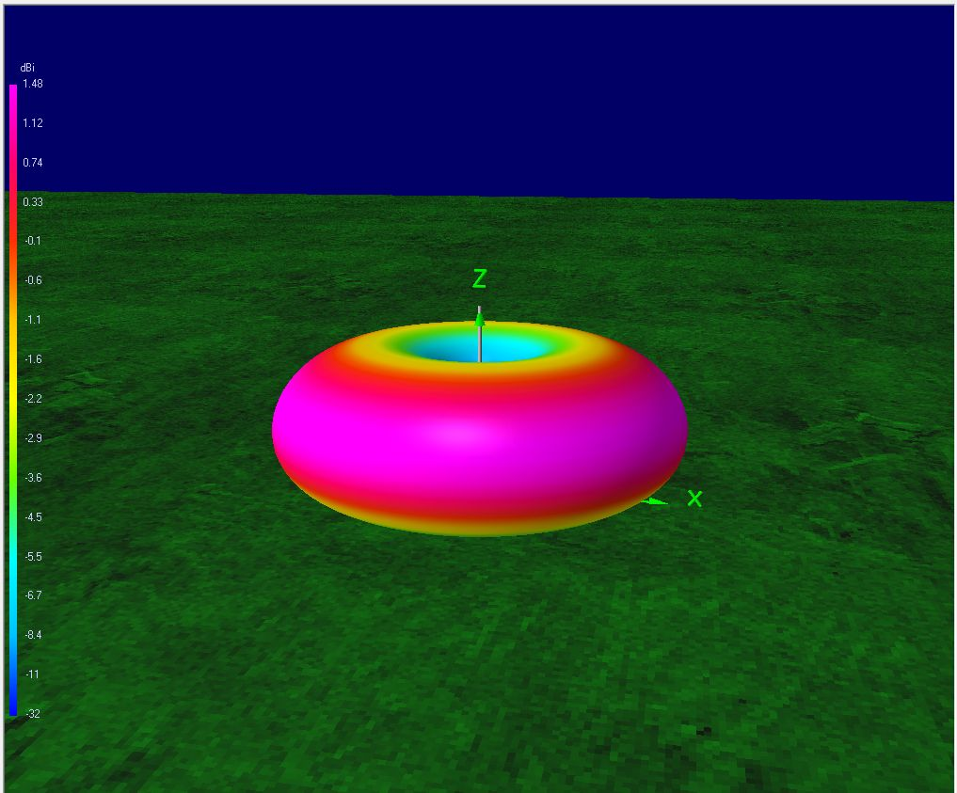
¼ λ Vertical w/ 20 Radials - Real Ground
λ/4 Vertical – 20 Radials, Real Ground

Slide 19
Where is the Power Going?
NEC simulations can tell us losses.
(assume perfect antenna conductors)
Over Perfect Ground 100% of energy in EM wave for both Horizontal and Vertical cases.
Horz. Dipole, λ/2 high with “Real Ground”: 75%
Vertical w/20 radial and “Real Ground”: 43%
If you aim the EM wave at resistive ground you will get losses.

Slide 20
Elevation Angles - LOCAL

Slide 21
Elevation Angles - DX

Slide 22
The DX Conundrum
How to get low elevation angles without heating the ground plane or throwing away energy into wasted sky modes.
High dipoles (wasted sky modes)
Yagi (can’t beat a tower and a beam! $$$)
Elevated Vertical Antennas
Other Multi-Element Antennas

Slide 23
Elevated Vertical Dipole
Pros:
No radials!
Good efficiency
Low angle Pattern
Cons:
Tall – needs a tree
Plans: see AF7NX at qrz.com

Slide 24
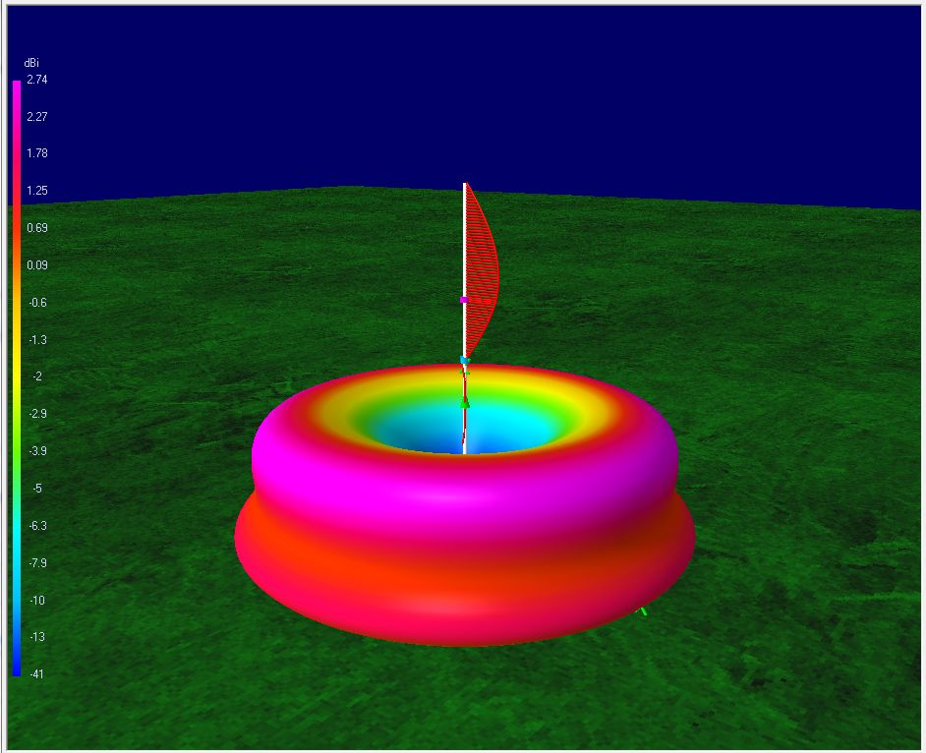
Elevated Vertical Dipole (70 ft. for 20 m)
Elevated Vertical Dipole
20m -- 70 ft. up

Slide 25
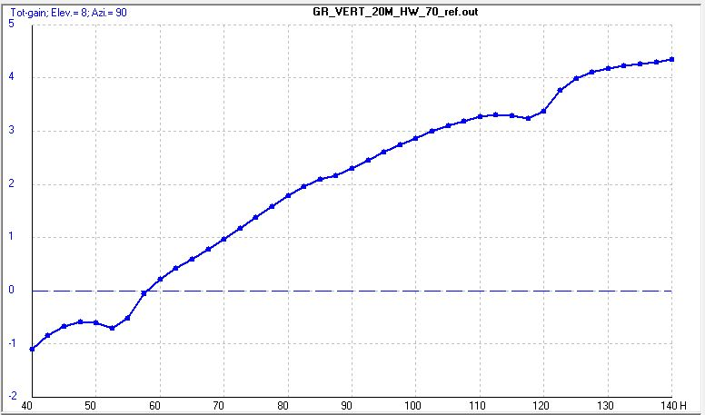
Vert. Dipole Gain at 8° -vs- Height
Top Height in Feet for 20m Vertical Dipole

Slide 26
Long Wires and Multi-Band Antennas
Harmonics on the wires
Spacing of the ham bands helps (sort-of)
Many tricks to make them all resonant and able to be matched to the feed line.
Many compromises!
Modes structures of higher harmonics generate predictable patterns.

Slide 27
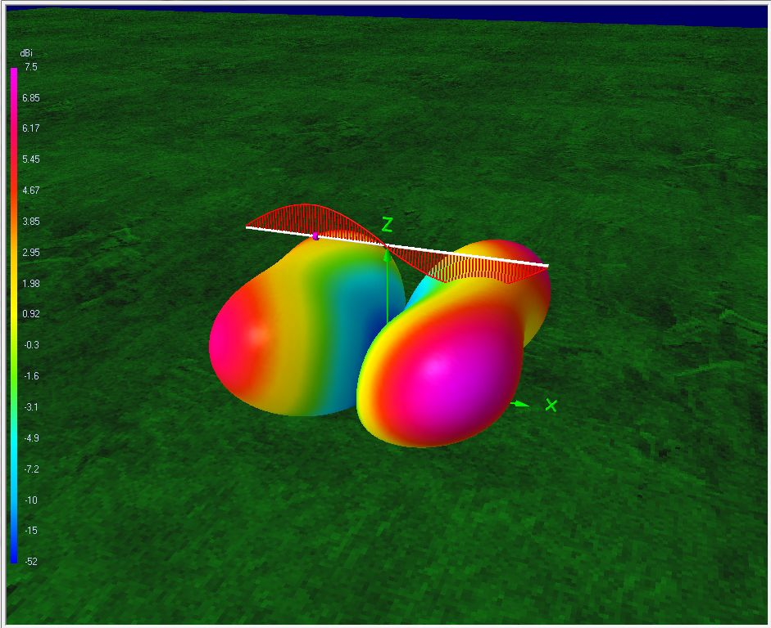
Second Harmonic
Second Harmonic λ/2 High

Slide 28
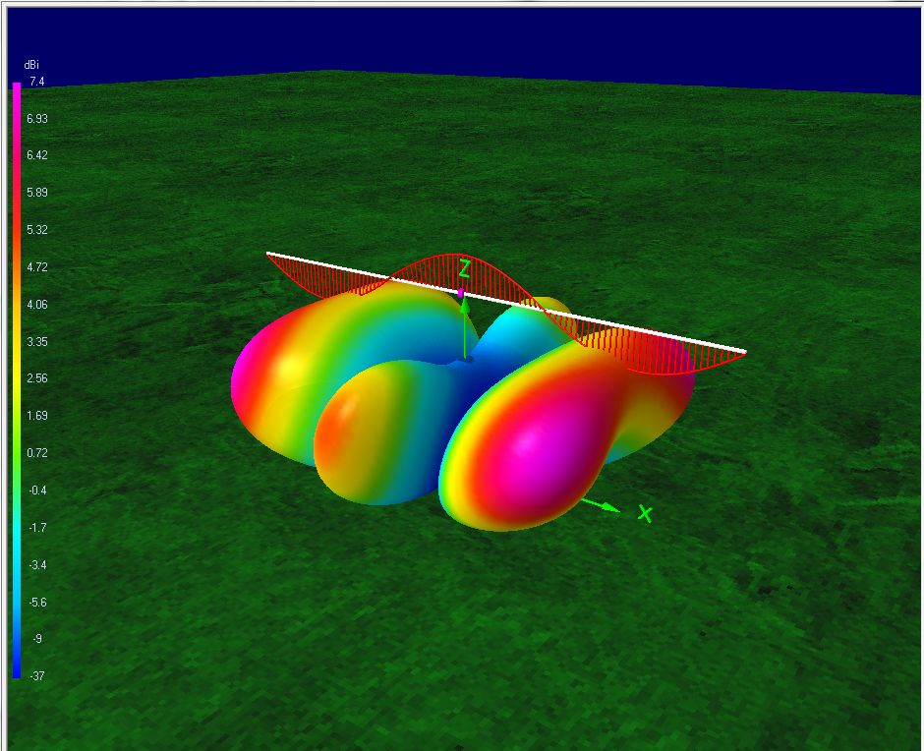
Third Harmonic
Third Harmonic

Slide 29
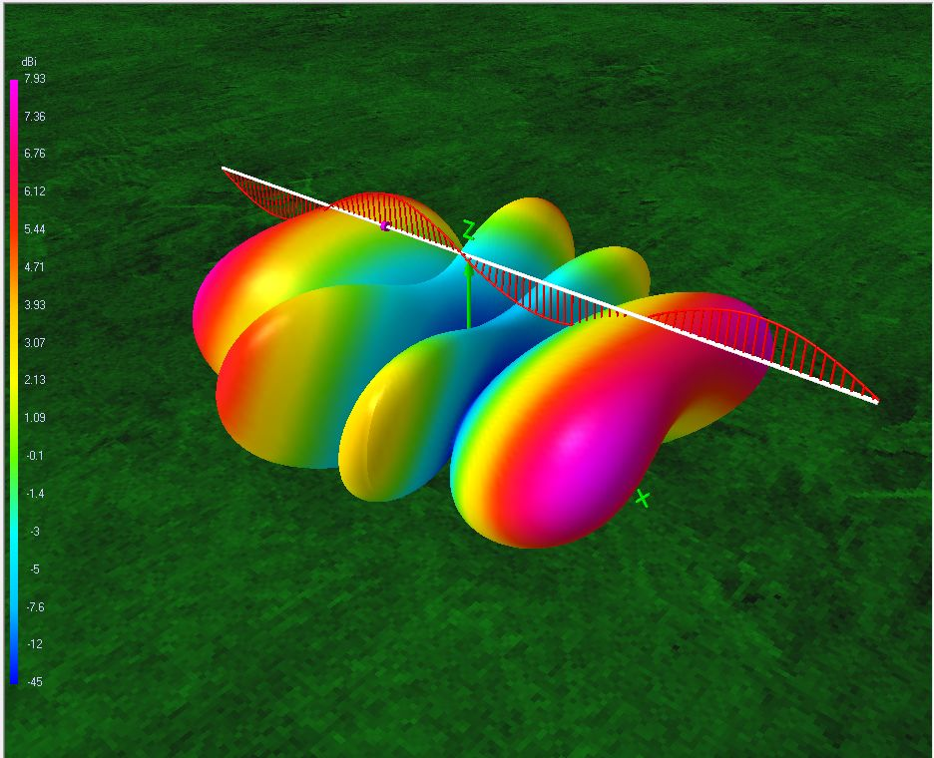
Fourth Harmonic
Fourth Harmonic

Slide 30
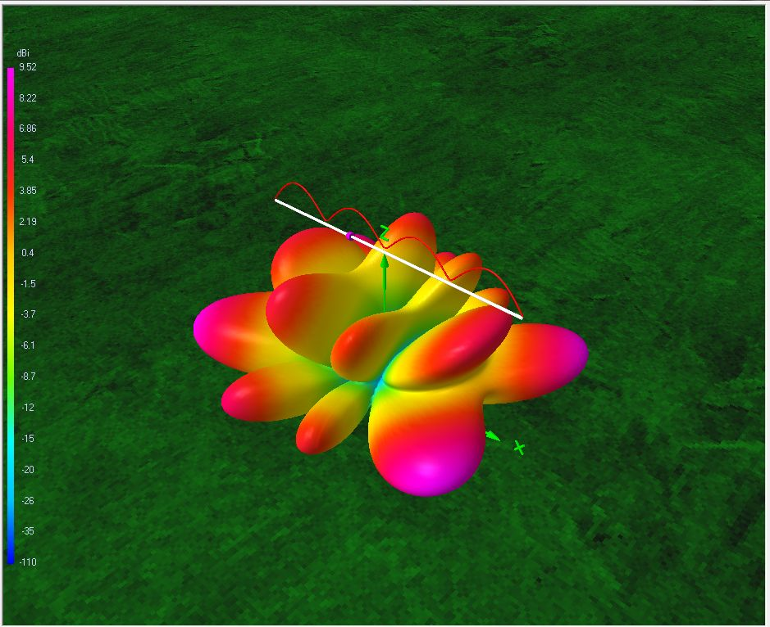
4th Harmonic Up 1 λ
Fourth Harmonic Up 1 x λ

Slide 31
Multi-Band Wires
Ham bands are harmonic (sort of) so multiple bands can be resonant on the same piece of wire.
“Broadside” to the wire doesn’t apply to higher harmonics.
Harmonic interference can give you strong lobes!
But aiming is important.

Slide 32
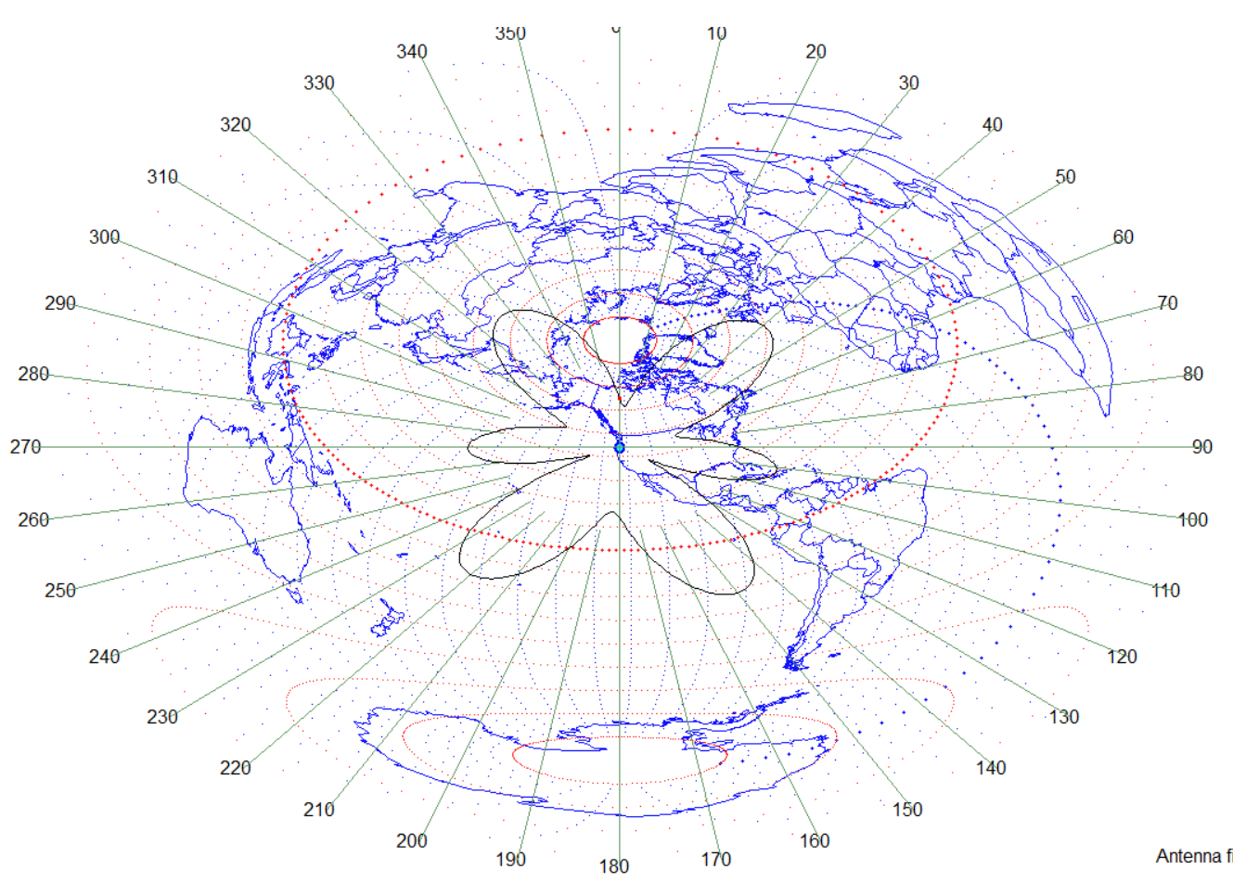
“Pizza” Map with Antenna Pattern Overlay

Slide 33
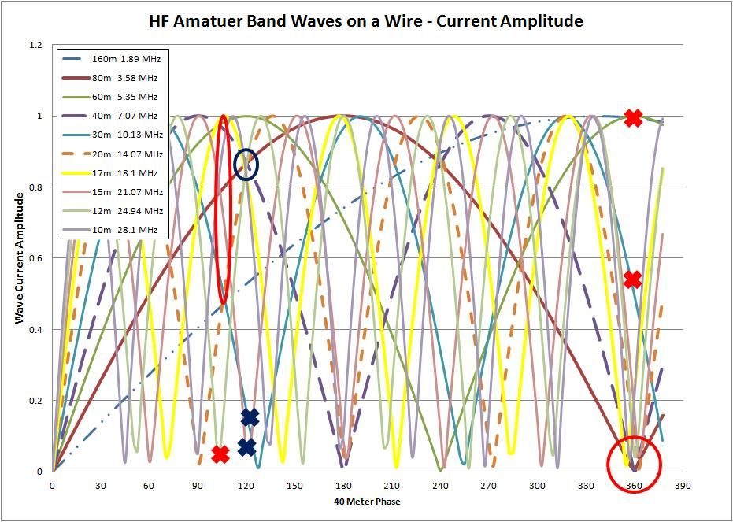
Fitting Waves on a Wire

Slide 34
Harmonics on Verticals
Any guesses?

Slide 35
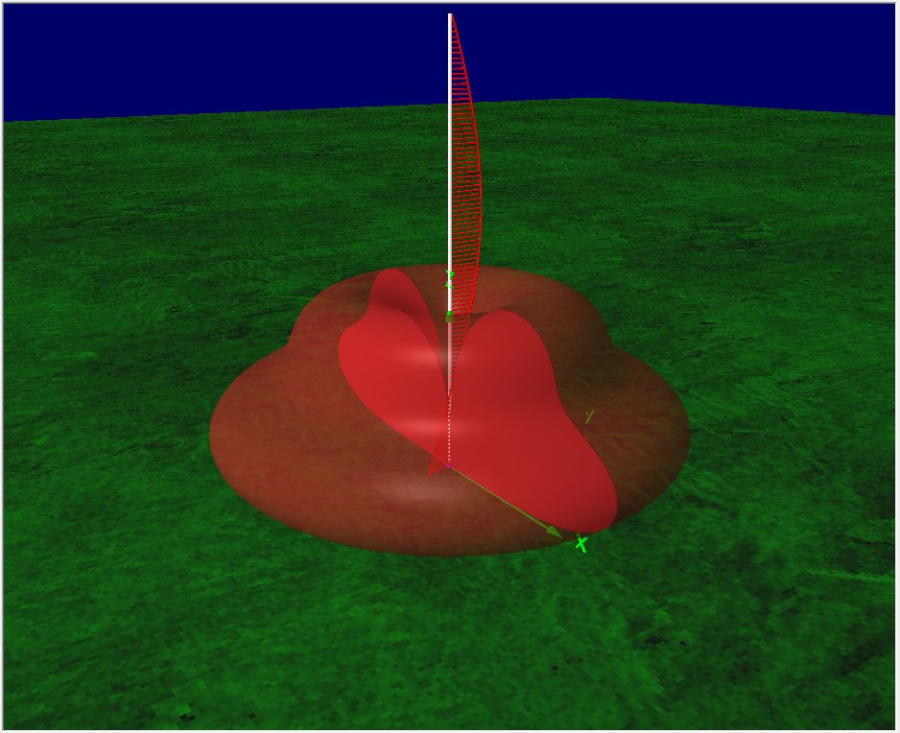
5/8 λ Vertical
5/8 Wave Vertical

Slide 36
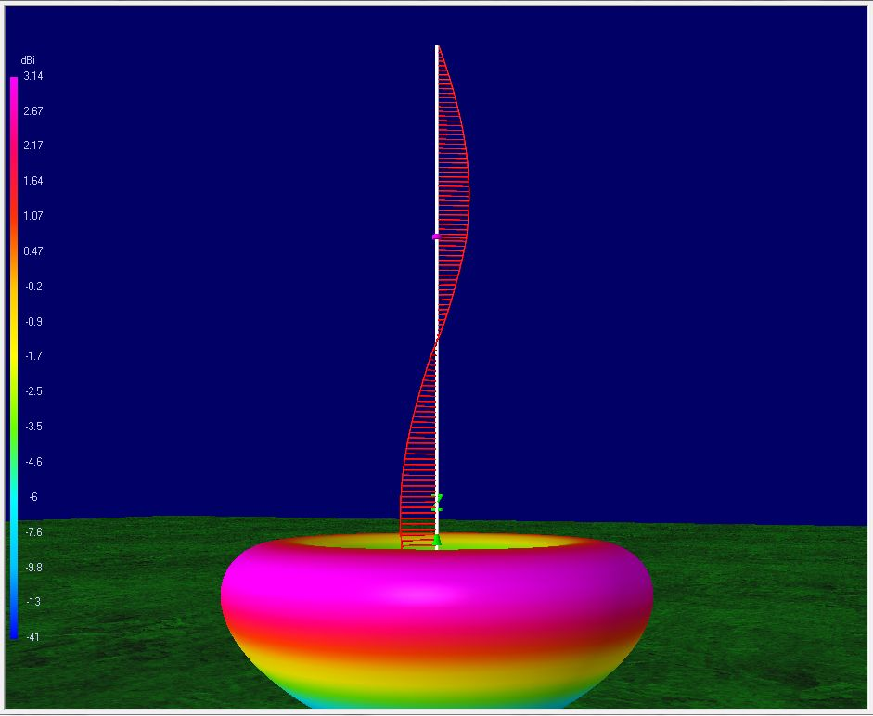
Full Wave Elevated Vertical
Full Wave Elevated Vertical

Slide 37
Antenna Comparisons
Description | Gain 30° | Gain 8° | Azimuthal Coverage | RDF (dB) | Top Height for 20 m | Comments
Dipole at λ/2 High | 7.2 dBi | 0.4 dBi | 2X 60° lobes | 8.5 | 10 m | Pretty good regional coverage.
4th Harmonic Wire at λ High | ~ 0 dBi | 7.6 dBi | 4X 25° lobes | 10.2 | 20 m | Pretty good DX if aimed where you want it.
λ/4 Ground Plane Antenna | 1.5 dBi | -2.9 dBi | 360° | 5.2 | 5 m
5/8 λ Ground Plane Antenna | ~ 0 dBi | ~ 0 dBi | 360° | 5.25 | 12.5 m
Elevated Dipole top 1 λ High | 1.4 dBi | 0.6 dBi | 360° | 5.3 | 20 m
Elevated Dipole top 2λ High | ~ 0 dBi | 4.2 dBi | 360° | 6.5 | 40 m | Pretty good DX all around
Elevated Full Wave Vertical λ High | 2.6 dBi | -9 dBi | 360° | 6.3 | 20 m | Good regional - Lousy DX
Elevated Collinear Dipole 2λ High | ~ -5 dBi | 4.9 dBi | 360° | 8.1 | 40 m | My Experiments
Elevated Collinear Dipole 2λ High Tilted 6° | ~ -5 dBi | 5.2 dBi | >180° | 8.4 | 40 m | My Experiments
3 El Yagi at λ/2 High | 12 dBi | 5.8 dBi | 1X 60° lobes | 13 | 10 m
3 El Yagi at λ High | ~0 dBi | 11.1 dBi | 1X 60° lobes | 14.2 | 20 m | Why you want a beam!

Slide 38
How much is a dB worth?
3 dB doubles your radio’s output and sensitivity.
10 dB makes your 100W rig as good as a 1kW rig for TX.
10dB will triple the possible reception area under marginal conditions. (assumes 1/r² intensity for radiation bounded by ionosphere.)

Slide 39
Conclusions
Using Wires for HF antennas is a common practice. Knowing what you should expect from the radiation patterns for waves on your wires will help you choose what will work best for your needs.
The principles of interference can lend insight into what to expect from a wire antenna.

