Slide 1
Practical Antenna Modeling
Using NEC Codes
With Examples of HF Wire Antennas and 4NEC2
Gary Rondeau , AF7NX

Slide 2
Overview
Describe the NEC codes
How to define and edit the models
Running the simulations and work flow
Work some examples
Using Variables
Deal with Feed Lines in the models
Grounds
Optimization
More Examples

Slide 3
The NEC Codes
Numerical Electromagnetic Code (NEC) were developed at LLNL in the 1970’s by Gerald Burke (r.i.p.) and Andrew Poggio.
“Engines” NEC2 freely available – plenty good for 90% of ham work
NEC4 pay to license ($110 from LLNL)- better with buried radials.
NEC5 new rewrite ($110 from LLNL) but also no longer
supported – doesn’t work w/ WIN 11
“Wrappers” include EZNEC (was commercial), 4NEC2 (free) and others. EZNEC now free and unsupported.
EZNEC - popular with ARRL – most popular because it’s “EZ”.
4NEC2 – Arie Voors, very powerful features – end-of-development because Visual Basic coding no longer supported by Microsoft. Uses NEC2 supports NEC4.
4NEC2 is what I use because of the ability to use variables and the ability to optimize them. – The native NEC2 version is just fine!

Slide 4
Why 4NEC2
>10,000 wires/ segments possible – only limited by memory and running time
Great graphics and plotting
Use of Variables
Optimization and Parameter Sweeps
4NEC2 Enhancements -- wire loading, fast grounds, auto-segmentation, convergence test, etc.
Freely Available https://www.qsl.net/4nec2/

Slide 5
Start by Defining Model Elements
Define Geometry of Antenna Wires and Radiating Elements
Define Voltage or Current Source(s)
Define Ground Plane (usually)
Define Transmission lines and R,L,C components and loads.

Slide 6
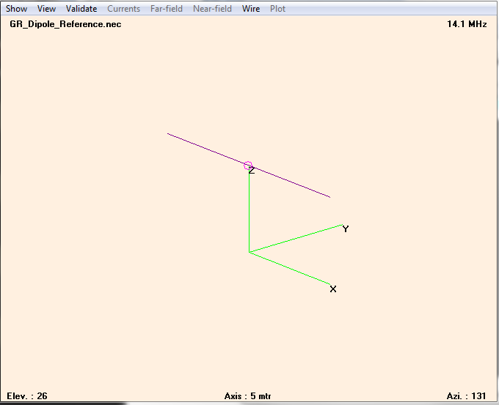
Example - 20m Dipole
NEC card format harkens to IBM puch-card days and remains the NEC file format
NEC “cards”:
CM 20 M DIPOLE
CE
Tag #segs x1 y1 z1 x2 y2 z2 r
GW 1 100 -5 0 5 5 0 5 0.001
GE 0
GN -1
EK
EX 0 1 50 0 1 0 0
FR 0 0 0 0 14.1 0
EN

Slide 7
4NEC2 Variables & Symbol Definitions
CM 20 M DIPOLE
CE
SY H = 10 'Height in Meters
SY LW1 = 10.0 'Length of Wire (meters)
GW 1 100 -LW1/2 0 H LW1/2 0 H #14
GE 0
GN -1
EK
EX 0 1 50 0 1 0 0
FR 0 0 0 0 14.1 0
EN
SY cards define variables that can be used to specify model parameters. But, use the more intuitive GUI editor!
The SY cards are the glue that makes 4NEC2 so powerful.

Slide 8
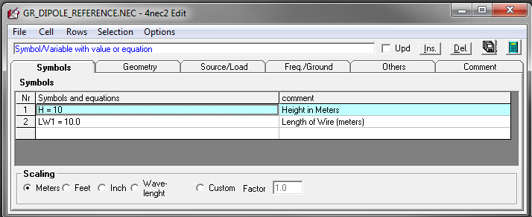
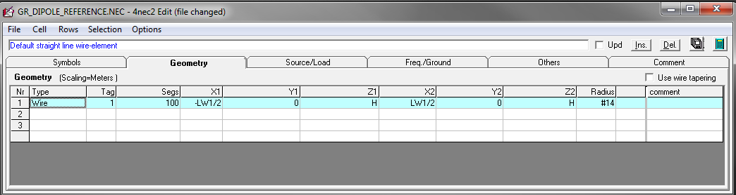
NEC editor (new)
Modern GUI makes entering data easier and with less mistakes.
NEC files saved with “card” format.

Slide 9
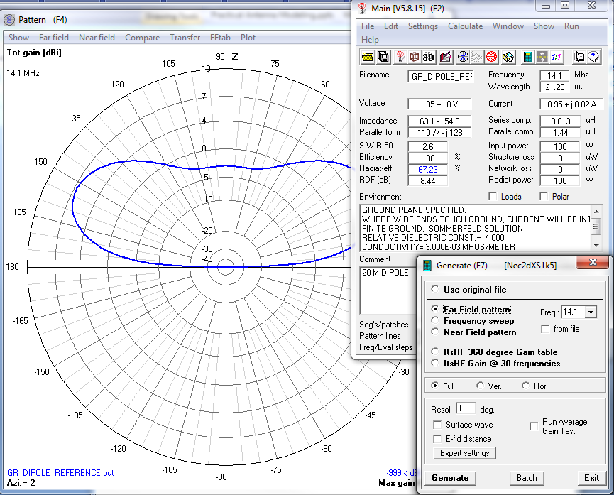
Simulations
Use the “Calculate” tab to launch the simulation.
“Far Field Pattern” most useful. You also get SWR for your feed geometry, radiated efficiency, RDF, etc.
For multi-band antennas, the “Frequency Sweep” is very useful to see how well you can load the antenna on various bands.

Slide 10
Model Basics
Wires have Tag numbers and are divided into Segments
Typically use 20 to 300 Segments per half-wave.
More Segments take longer to run. Use 4NEC2 “AutoSegment” utility.
Wires with the same endpoints are joined together
Sources and Loads are placed on specific Segments
Transmission Lines and Ground Planes (“perfect” and “real” grounds) are supported
NEC determines the self consistent current in all of the wire segments due to the Sources. Then determines the fields produced by the currents. Magic as far as we are concerned!

Slide 11
Work Flow
Enter Geometry
Validate geometry, feed, loading, etc. (Look at graphics and run Segment Checks.)
Run Simulation
Look at results
Can we make it better?
  Yes - Modify geometry, feed, loading, etc. – optimize.
  No – Then time to build and test the antenna and verify the simulation – or try something new.

Slide 12
Modeling Examples
Following examples illustrate a variety of 4NEC2 functions and abilities.
Enough input data is shown to allow duplication so you could run it yourself.
Wide variety of complexity from very simple to complicated “cut-to” recipe.

Slide 13
Example: 80m OCFD
How long?
Where is the feed point?
Use a Balun? What ratio?
Feed line? - The “Windom” designs include the vertical feed line section. Does it work?
I want good performance on 20m & 30m.
I have a pile of 75 Ω co-ax… can I use it?

Slide 14
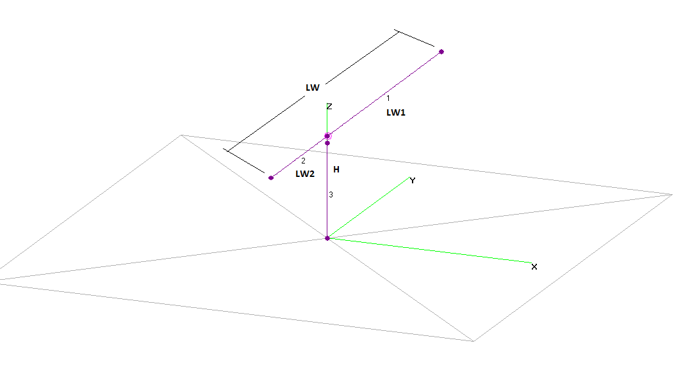
OCFD Geometry
Geometry includes the feed coax which you can connect to one side of the antenna (direct coupling) or not (using a balun).
Place the driving source on antenna wire.

Slide 15
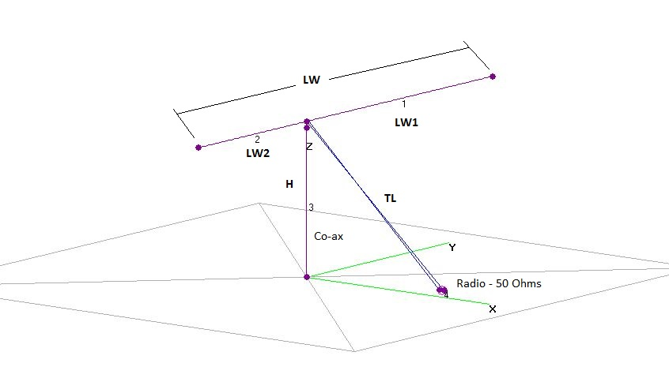
Example: OCFD w/Coax Feed
Include the co-ax feed line as antenna element going to ground and the internal transmission line to the TX.
Driving source at the end of a transmission line.

Slide 16
Choose Meaningful Variables
Height H = 15m
Overall Length LW = 41m
Fractional length at feed F = 0.67
Express various lengths in terms of parameters:
LW1 = LW * F Length of long section
LW2 = LW – LW1 Length of short section
Say all this with SYMBOLS & EQUATIONS before you define the geometry.

Slide 17
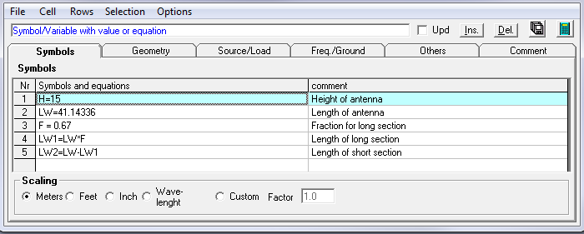
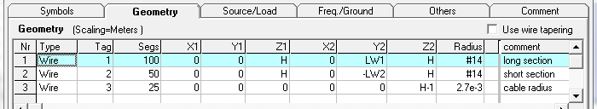
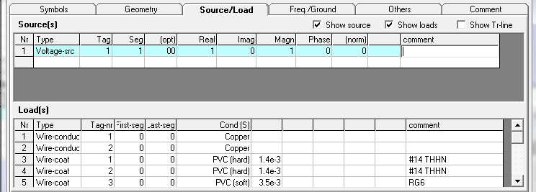
80m OCFD Description

Slide 18
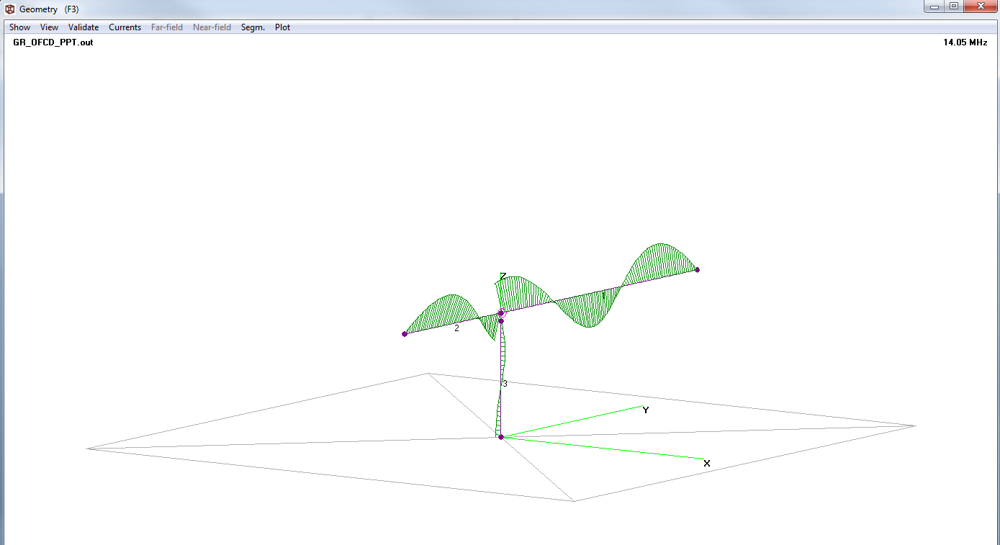
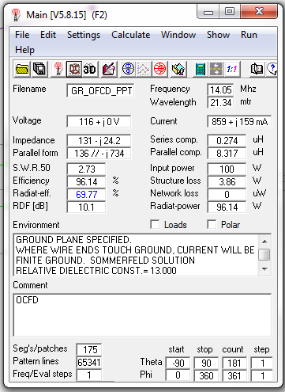
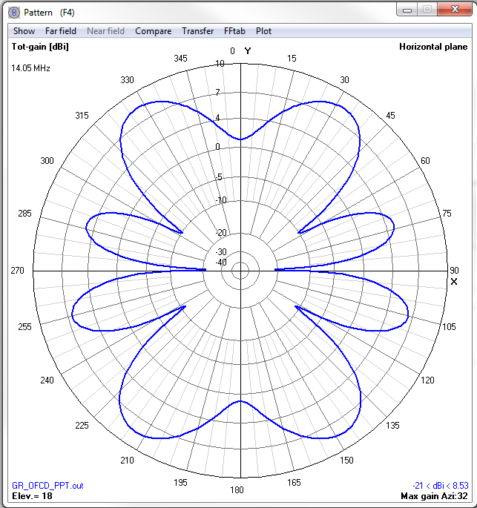
Initial Run – 20m
Calculated Far-Field Pattern 14.05 MHz

Slide 19
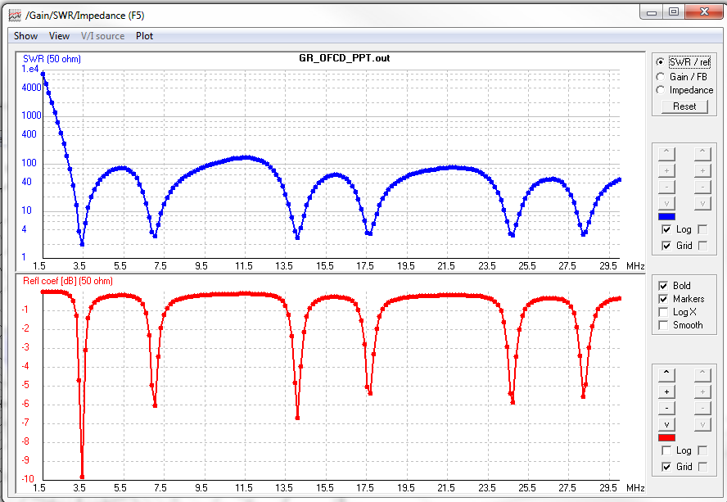
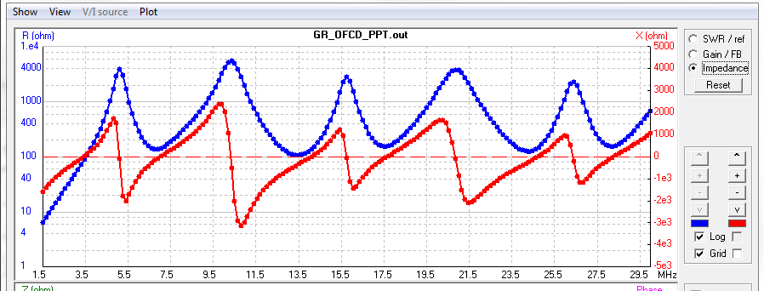
Frequency Sweep
The impedance graph shows that the antenna would do better driving 200Ω rather than 50Ω. Plan on a 4:1 Balun.
Treat baluns as ideal transformers. Change source impedance from 50 Ω to 200 Ω with 4:1 balun.

Slide 20
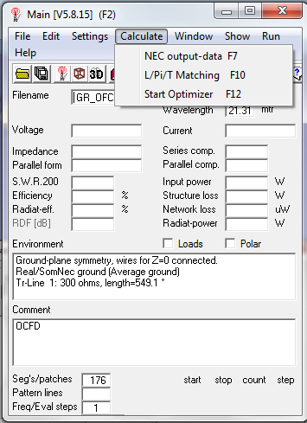
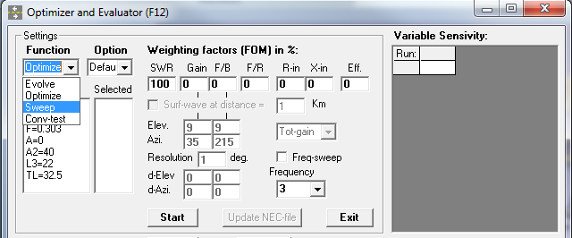
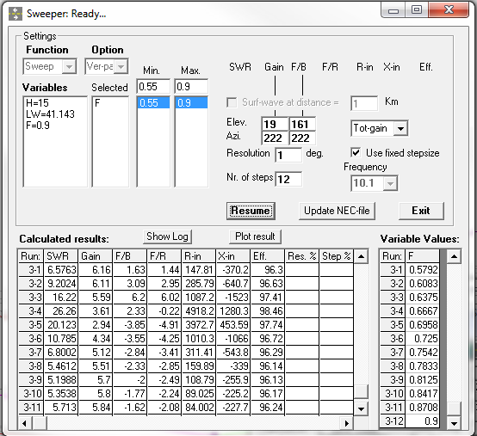
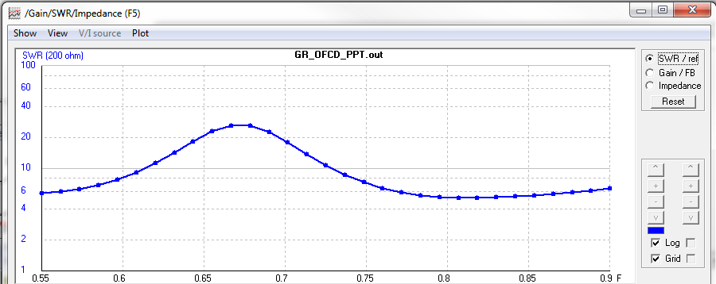
Excersize: Optimize feed point for 30m
Previous design with F=0.67 does pretty well with the 80, 40, 20, 17, 12, and 10 meter bands.
But I want 30m…
Sweep F from 0.55 to .9 and look at SWR for 10.1MHz

Slide 21
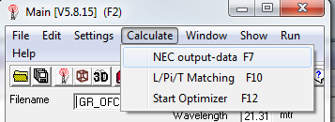
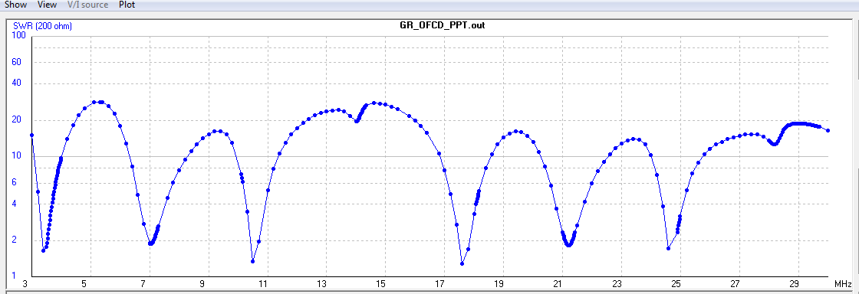
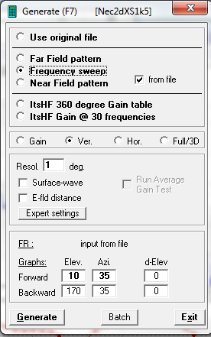
See what happens with F=0.75
Unfortunately we lost 20m but improved 30m, 15m & 12m
Use FREQ.TXT list to emphasize the ham bands
The antenna will work for a particular frequency when:
The structure is cut to have a natural resonance at that frequency
The structure is fed in a manner that can excite the frequency.
Need both!

Slide 22
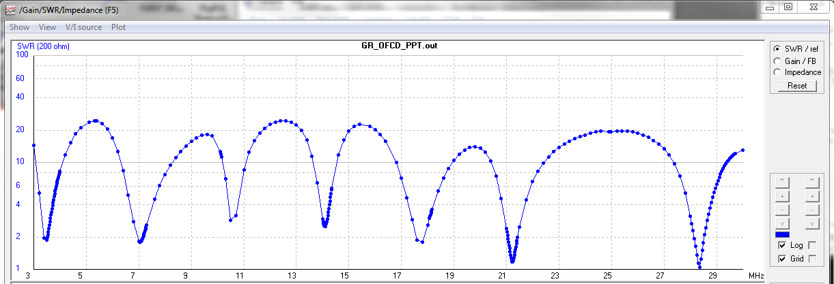
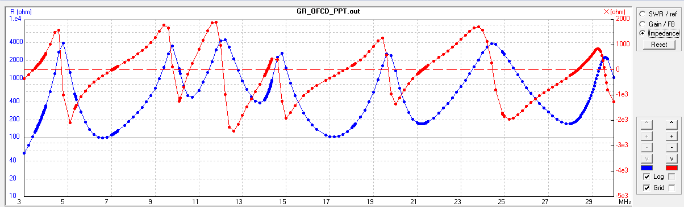
Try F=0.72
Gets more of 20 and some of 30…
Pushing F has raised the impedance for 20m and 30m. Maybe try 300Ω feed, include coax transmission line,
etc…
Pretty soon you have your own unique design…

Slide 23
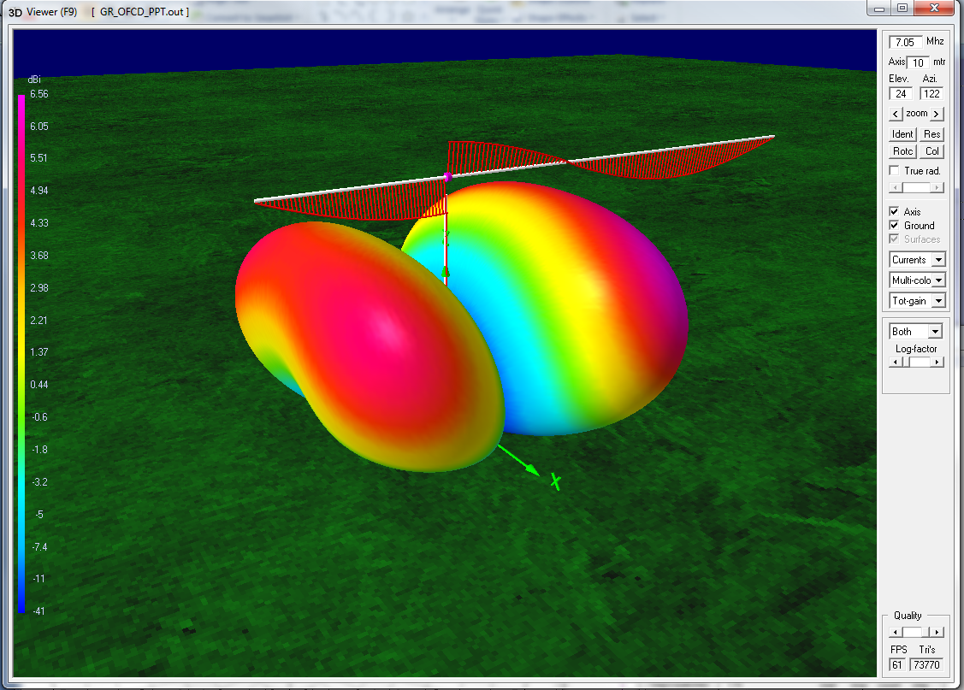
Nice Graphics
This is the previous OCFD on 40m.
Verify expected pattern, gain, and RF currents for a particular band.

Slide 24
Real Wires
Specify wire size AWG, e.g. #12, or radius.
Loading – Wire material Copper, Aluminum, etc.
Loading – Insulated wires. PVC, Teflon, Nylon, etc. Pitfall - be sure to get the radius correct in the appropriate units. (feet!?)
Should get about 4% length correction for THHN house wire. Check it!

Slide 25
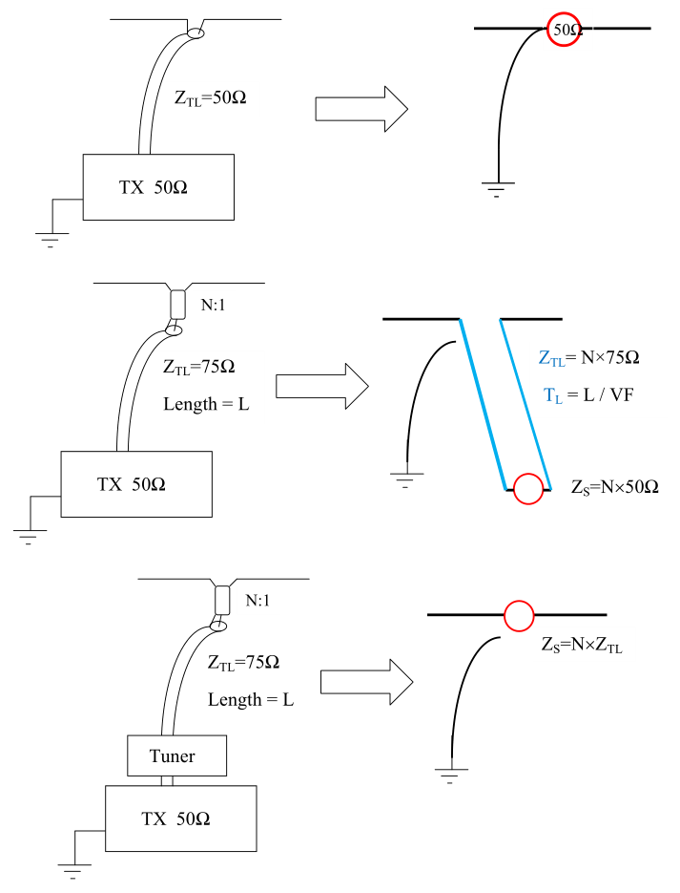
Modeling the Feed Line & Baluns
Don’t neglect the effects of the feed wire itself as an antenna element!
Transformers are not modeled directly. Instead change the impedance, seen at the antenna, as reflected through the transformer.
From the antenna’s POV see feed line impedance with unknown termination at tuner.
Approximate

Slide 26
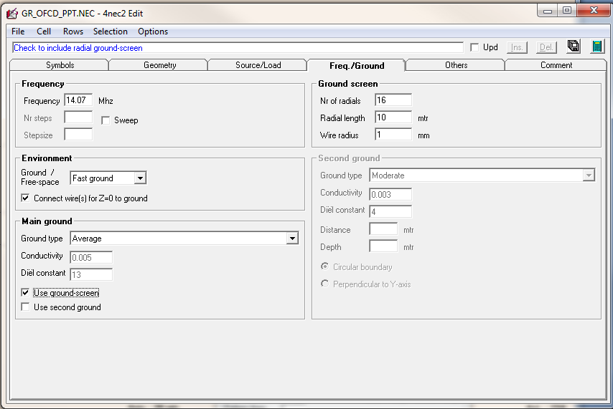
Grounds
Lots of options for Ground. In the drop-down menus.
“Fast Ground” allows for radial array ground screen.
Main Ground provides specific soil or environment type options for relevant conductivity and dielectric constant.
NEC4 handles ground more realistically than NEC2, especially buried radials.
I use “Average Ground” all the time so I can compare antenna performance rather than ground properties.

Slide 27
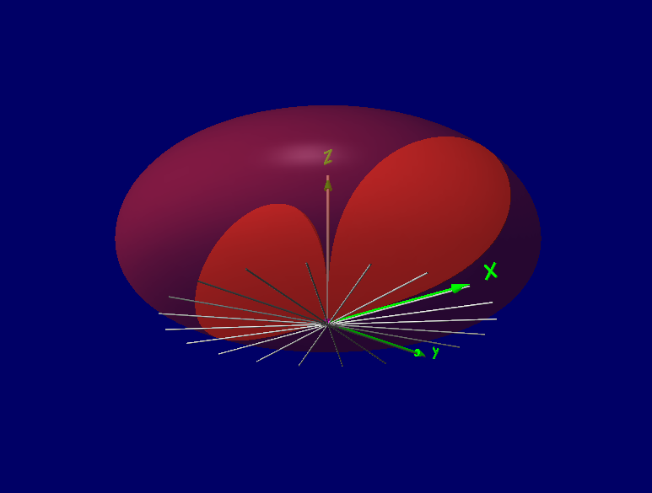
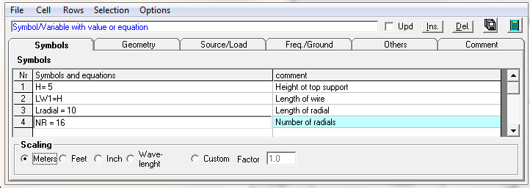
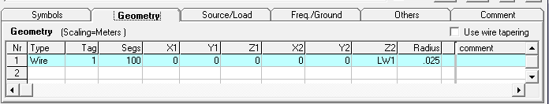
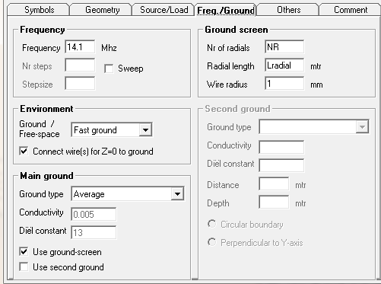
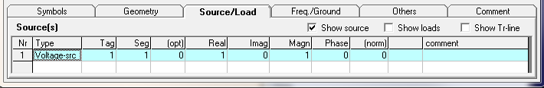
Example: Mono-band Vertical Antenna

Slide 28
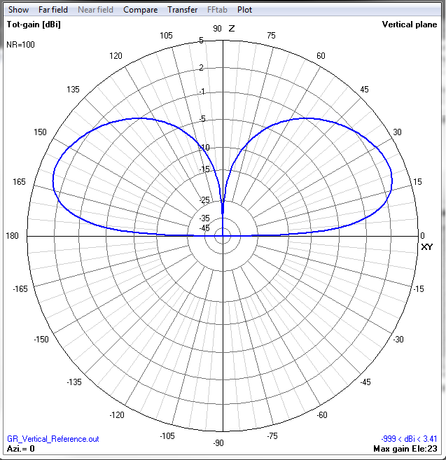
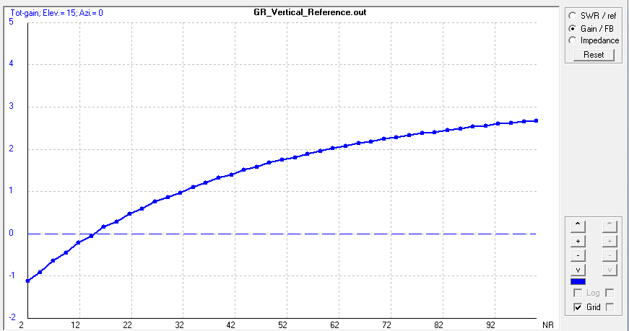
Problem: How many radials?
Look at 15° elevation gain. Sweep NR with 10m radials.

Slide 29
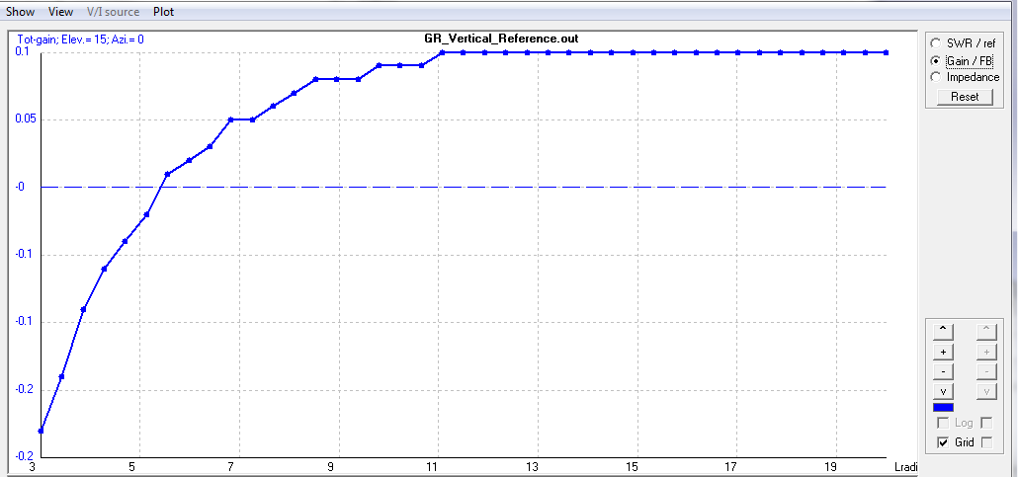
How long for the radials?
Look at 15° elevation Gain and sweep L radial with 16 radials.

Slide 30
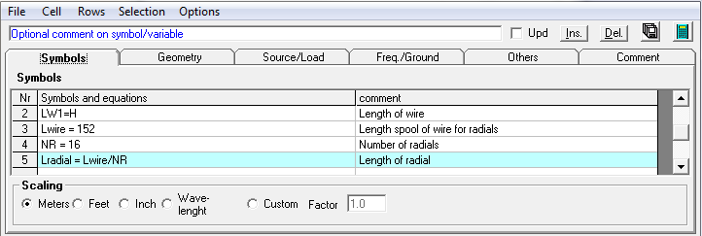
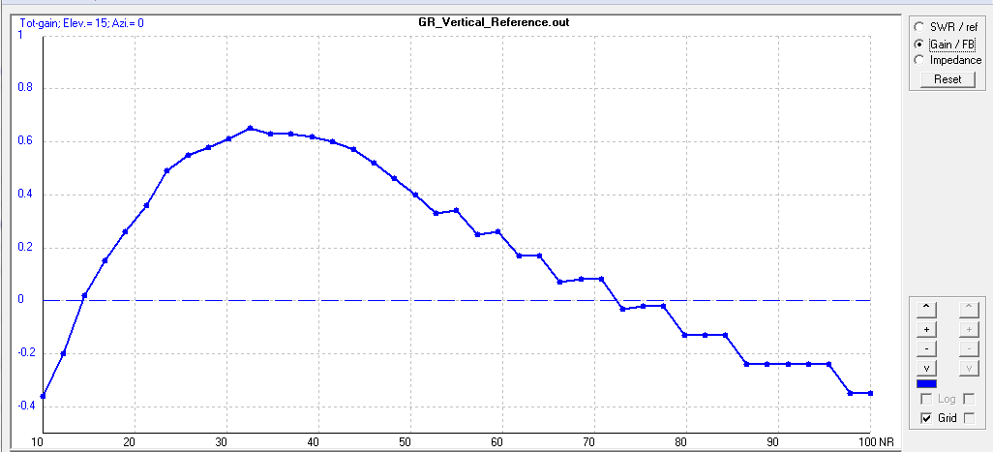
Optimize for 500 ft. of wire
Lwire = 500’ = 152m = NR × Lradial
Now we can optimize NR
Best is 34 radial about 4.5m long.
How much gain for the next 500’ spool?

Slide 31
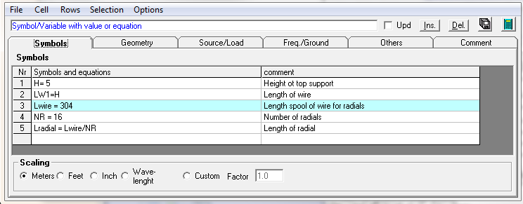
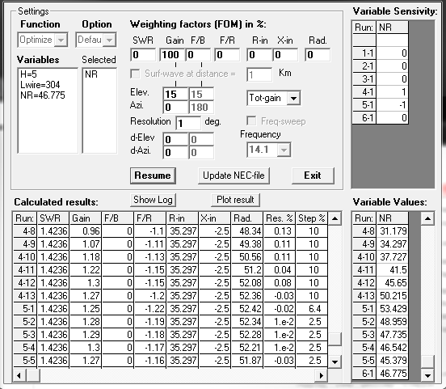
1000 ft. of radial wire…
This time use “Optimize” rather than “Sweep”
Gone from 0.6 dB to 1.3 dB at 15°, now with 47 radials about 6.5m long.
500’ of #14 copper ~$50 so about $70/dB (plus a bit of shovel work)
Do it again for 1500’ of wire?

Slide 32
Example: Pull-up 20m Vertical
Simple idea uses several modeling features:
  Lumped impedance for feedline choke
  Coated wires – THHN and Coax-Jacket
  Transmission line feed
Variables to optimize:
  Length of two sections of dipole – use 4NEC2
  Length of transmission line feed – use 5/4 λ
  Impedance of choke, L and C - want trap for 20m
Trying to use 4NEC2 to optimize everything at once is a fools errand – make educated guesses!

Slide 33
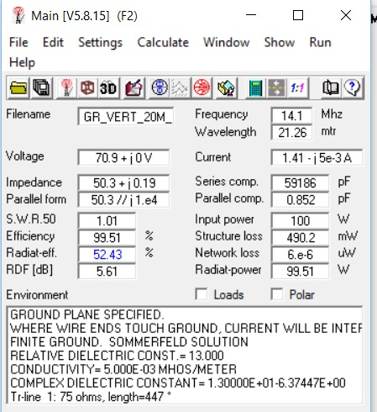
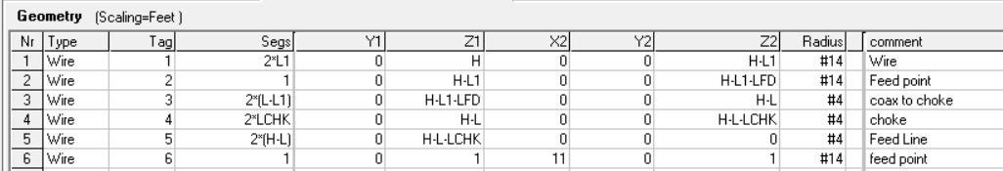
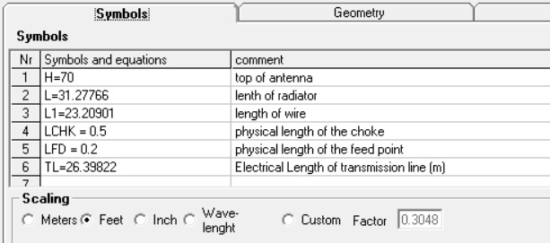
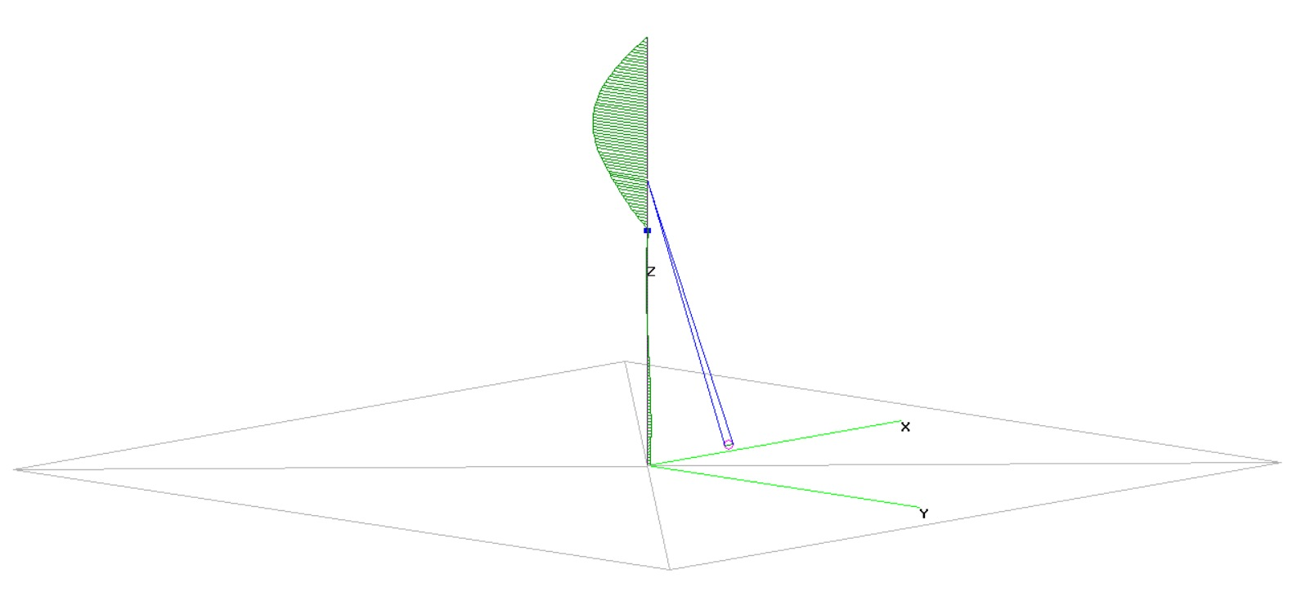
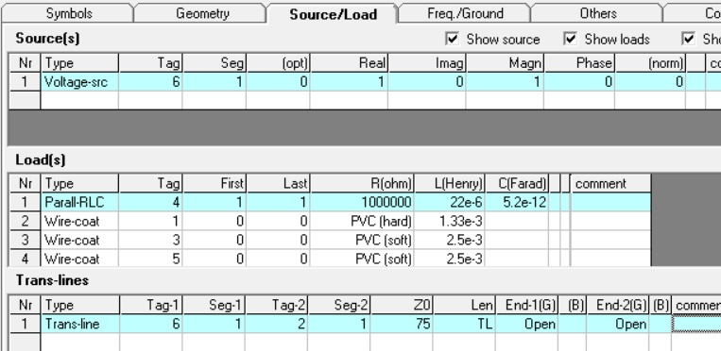
20m Pull-up Vertical Dipole
No Radials!

Slide 34
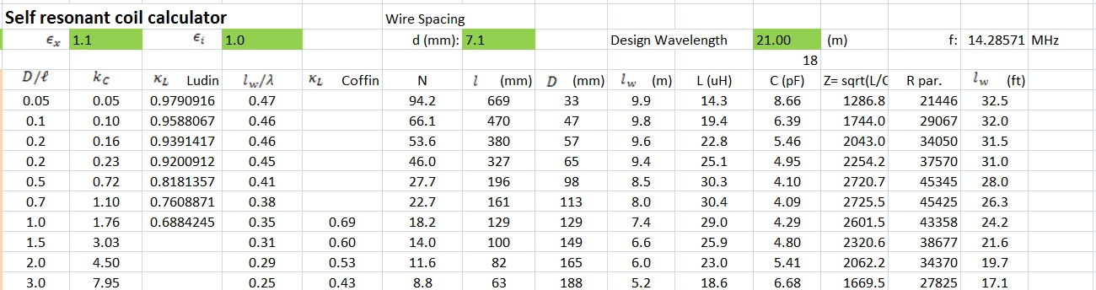
The Inductor Problem
Modeling inductors properly is tricky because:
  Inductors are often distributed in space (not small compared to λ) so a lumped circuit model is often not appropriate.
  Segmentation length limit of λ/1000 prevents direct modeling for tight helixes.
  Useful inductors are often used near resonance where properties are rapidly changing.
  Capacitance associate with the inductor is a non-ignorable nebulous quantity.
My self resonant coil calculator after David Knight, G3YNH

Slide 35
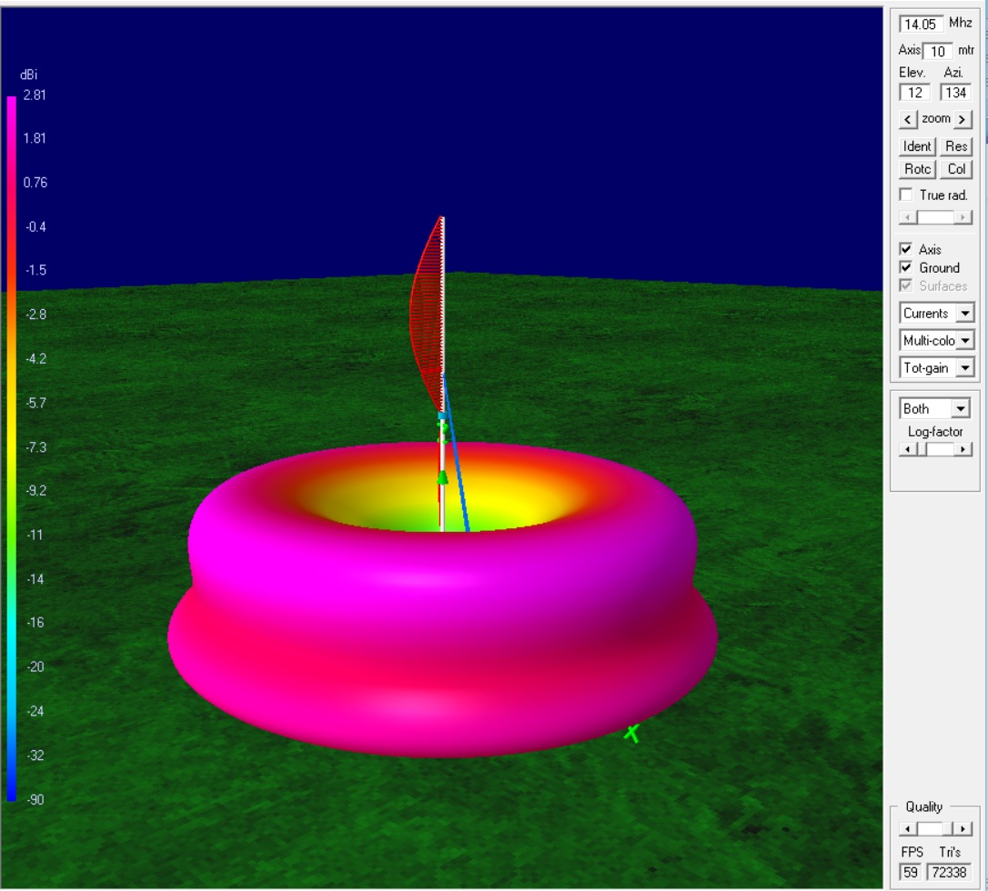
20m Vertical Dipole
One piece of 75 Ω coax
One piece or #14 THHN house wire
Single pull-up point.
No radials
Good low elevation pattern.
SWR ~1

Slide 36
Multiple Phased Antennas
Large subject…
  A Yagi is a multi-element phased array
  Phase two, three or four verticals to steer the pattern.
  Curtain arrays – VOA did this in a big way.
  Collinear arrays, V-beams, many more…
Example - consider two low dipoles.
  Low dipoles are sky warmers
  Place two side by side separated by < λ/2
  Worthless sky wave is same on both so subtract signals!

Slide 37
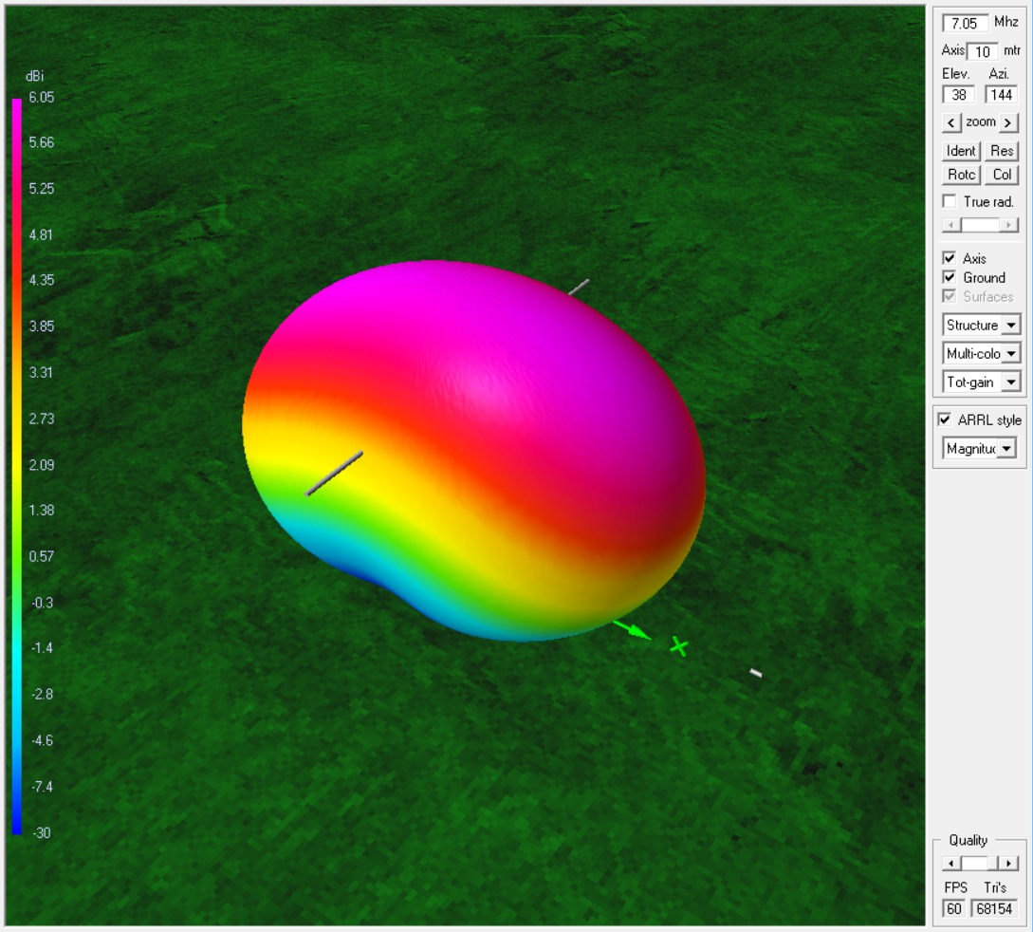
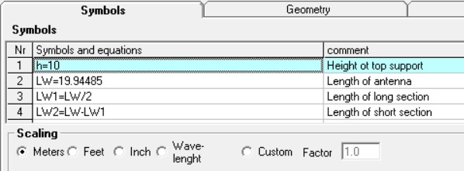
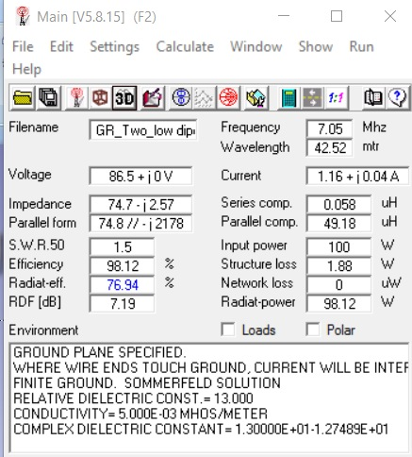
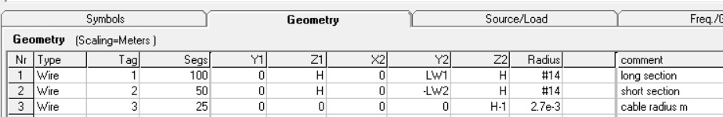
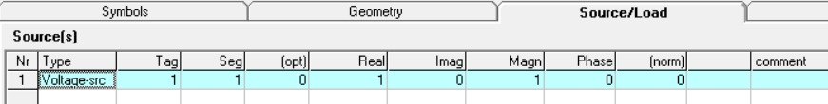
40m Dipole at 10m high
Note impedance seen at antenna is very
close to 75Ω. SWR 1.5 for 50Ω driver.

Slide 38




Two
Dipoles
General representation of
two dipoles, separated by
2* Xo and 2* Yo and at
Angle Ao.

Slide 39


Two 40m Dipoles
A(0) –B (0)
suppresses sky wave
A (0) – B (delay = spacing)
emphasizes one direction
Change direction by switching which cable has the extra phasing length

Slide 40


Phased Dipoles
Sweep PH from 0 to 20 m and look at Gain, F/B and SWR.
Best gain has high SWR. More work to do…
Consider series feed or 4:1 at radio…

Slide 41
Example: VHF Coax Collinear Vertical
NEC for VHF & UHF too.
Can a 20m collinear design I did work on 2m?
Use 75Ω coax.
Traps for 145 MHz – use my coil calculator:
  1.6 ft., 2.5 turns at ~2.4 in. dia. of RG-6
  0.54 μH, 2.3 pF
Optimize design for LQ, TL2, RT for gain at 10° elevation and SWR.
This example generates a “recipe” so include wire coating loads.

Slide 42



2 m Collinear Vertical Model

Slide 43



2 m Collinear Results
Does it work? Need to build it and find out!

Slide 44
Can You Trust It?
I wouldn’t… verify!
Check convergence of model.
  Calculate-Optimize-Conv-test will run the setup with more segments – should get similar answer!
Measure wires lengths, heights, etc. when you build. Verify what you actually built!
Include effects of gutters, Al siding, other wires, fences if any are near the antenna.
Measure SWR sweep with antenna analyzer!

Slide 45
Concluding Thoughts
Simple models provide insight even if not a finished design.
Running a dozen models will give you more understanding than building those antennas.
Models are good enough to “cut to” if you include everything. Plan to fine tune!
Models let you exclude bad ideas quickly.
Be creative!

